Slide 1
Velocity Motion Model (cont)

Slide 2
Velocity Motion Model
center of circle
where

Slide 3
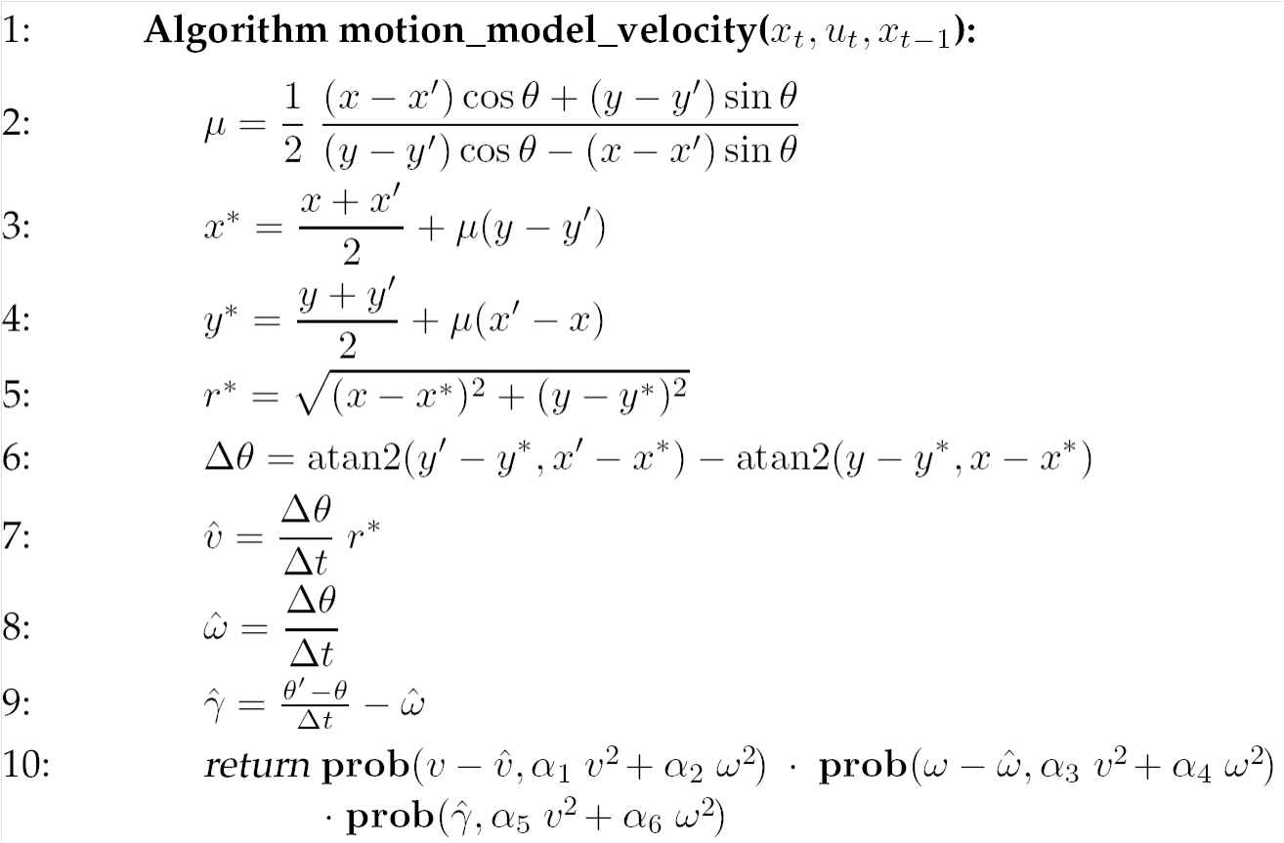
Velocity Motion Model

Slide 4
Velocity Motion Model
rotation of Δθ about (x*, y*) from (x, y) to (x’, y’) in time Δt
Lines 2, 3, 4
Line 5
Line 6

Slide 5
Velocity Motion Model
given Δθ and Δdist we can compute the velocities needed to generate the motion
notice what the algorithm has done
  it has used an inverse motion model to compute the control vector that would be needed to produce the motion from x_{t-1} to x_{t}
  in general, the computed control vector will be different from the actual control vector u_{t}
Steps 7, 8

Slide 6
Velocity Motion Model
recall that we want the posterior conditional density
of the control action u_{t} carrying the robot from pose x_{t-1} to x_{t} in time Δt
so far the algorithm has computed the required control action
needed to carry the robot from position (x y) to position
(x’ y’)
  the control action has been computed assuming the robot moves on a circular arc

Slide 7

Velocity Motion Model
the computed heading of the robot is
the heading should be
the difference is
or expressed as an angular velocity
the in-place bearing error; i.e., the amount
the robot must rotate by at the final
location to achieve a
bearing of $θ′$
Line 9,
Eq 5.25, 5.28

Slide 8
Velocity Motion Model
similarly, we can compute the errors of the computed linear and rotational velocities

Slide 9
Velocity Motion Model
if we assume that the robot has independent control over its controlled linear and angular velocities then the joint density of the errors is
what do the individual densities look like?

Slide 10
Velocity Motion Model
the most common noise model is additive zero-mean noise, i.e.
we need to decide on other characteristics of the noises
  “spread” variance
  “skew” skew
  “peakedness” kurtosis
typically, only the variance is specified
  the true variance is typically unknown
actual
velocity
commanded
velocity
noise

Slide 11
Velocity Motion Model
assumes that the variances can be modeled as
where the α_{i} are robot specific error parameters
  the less accurate the robot the larger the α_{i}
  assumption models standard deviation of the noise is proportional to the commanded velocity of the robot
Eq 5.10

Slide 12
Velocity Motion Model
a robot travelling on a circular arc has no independent control over its heading
  the heading must be tangent to the arc
this is problematic if you have a noisy commanded angular velocity ω
thus, we assume that the final heading is actually given by
where is the angular velocity of the robot spinning in place
Eq 5.14

Slide 13
Velocity Motion Model
assumes that
where
actual
velocity
noise
Eq 5.15

